Slide 1
CSCI 222 Lab Assignment 2 – Team C1
Deston Guay (Team Leader), Euguene Lee, Joshua Tan, Darwin Tan, Benedict Say, Randy Tung

Slide 2
Agendas
Class Diagram
Data Dictionary
Component Diagram
Sequence Diagram
Use Case Diagram
Risk Analysis Management & Countermeasures
Deployment Diagram
Notes:
Are we still going to present sequence diagram? Should we replace it with business case? The smartart chart is limited to 7 only.

Slide 3
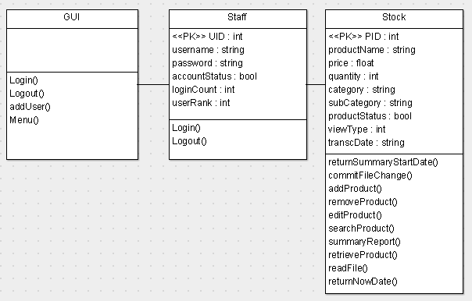
Class Diagram

Slide 4
Data Dictionary

Slide 5
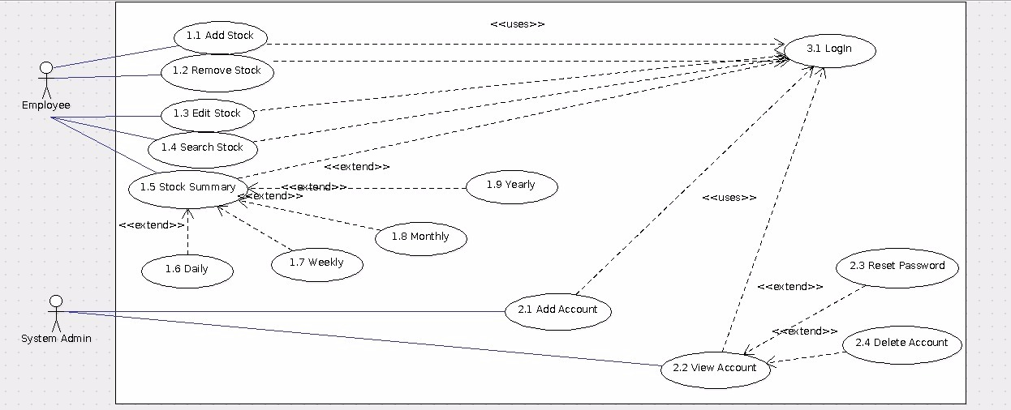
Use Case Diagram

Slide 6
Sequence Diagram

Slide 7
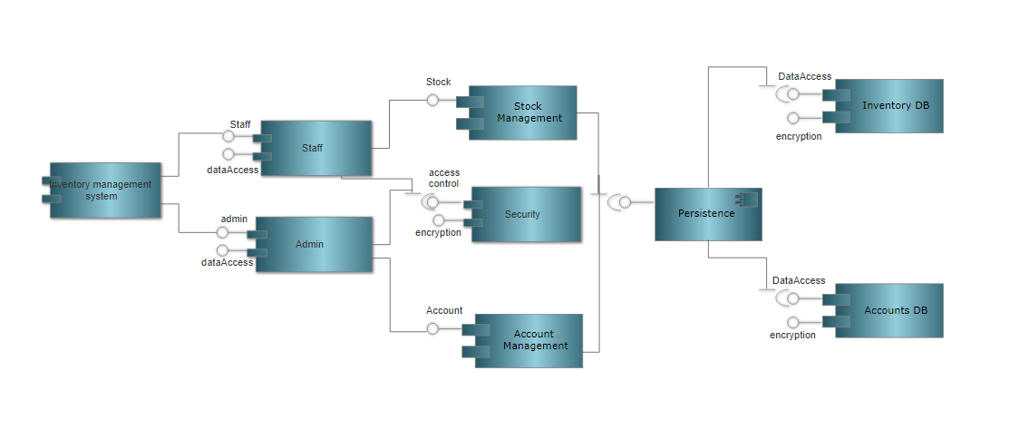
Component Diagram

Slide 8
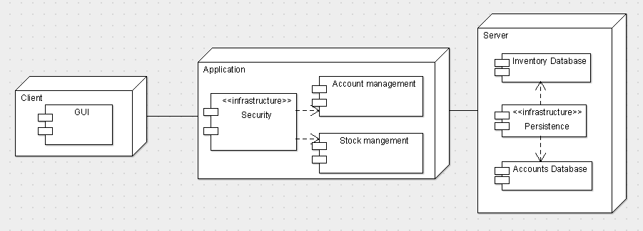
Deployment Diagram

Slide 9
Risk Analysis Management & Countermeasures
 | Impact Type | Risk Seriousness (%) | Likelihood of Occurrence (%) | WBS (affected work / task) | Risk Description
1 | Budget | 30% | 5% | All | All employees demand an increment of salary.
2 | Competitive | 50% | 30% | Stock | Potential competitors to institute a price war to cause a drop in revenue.
3 | Compliance | 10% | 5% | All | A risk level that the company will be deemed to have violated a law or regulation.
4 | Operations | 50% | 10% | All | The potential risk for failures of the company’s core business processes.
5 | Security | 20% | 20% | All | Risks related to physical and information security.

Slide 10
Risk Analysis Management & Countermeasures
 | Risk Description | Proposed Mgmt Plan | (Possible) Reduction in Risk Seriousness (%)
1 | All employees demand an increment of salary. | Plan 1: Propose appropriate increment of salary | -20%
 |  | Plan 2: Replace disgruntled workers | -20%
2 | Potential competitors to institute a price war to cause a drop in revenue. | Plan 1: Offer discounts and benefits for customers | -50%
3 | A risk level that the company will be deemed to have violated a law or regulation. | Plan 1: Ensure that the country’s laws and legislature are adhered to at all times. | -10%
4 | The potential risk for failures of the company’s core business processes. | Plan 1: Ensure business continuity plan is in place and rehearsed with employees. | -50%
5 | Risks related to physical and information security. | Plan 1: Review security processes frequently | -10%
 |  | Plan 2: Review inactive accounts and implement a password change policy | -10%

Slide 11
Question & Answer

